Slide 1
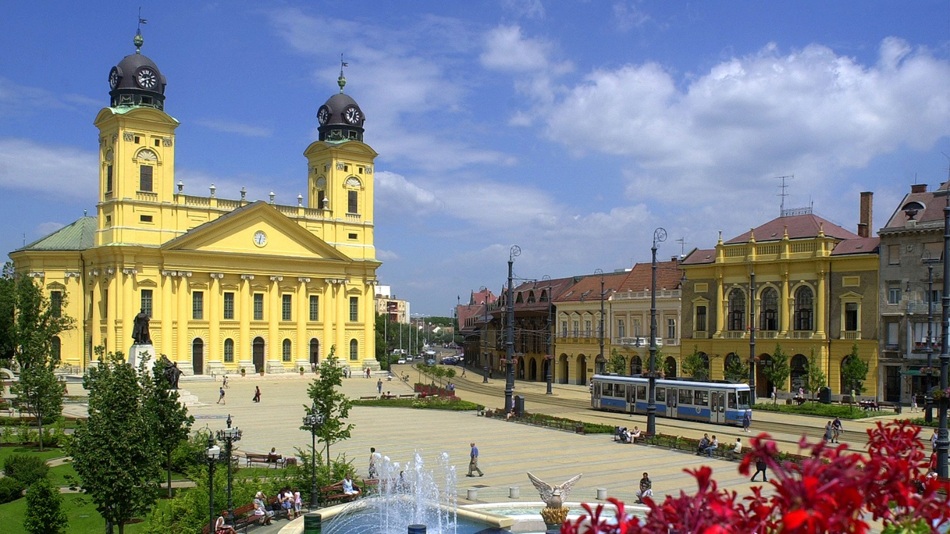
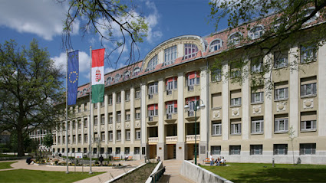
Effects of acute alcohol consumption on neuronal activity and cerebral vasomotor response
Eszter Balogh, Tamás Árokszállási, Katalin Körtefái, Veronika Nagy, László Csiba, László Oláh
Department of Neurology, University of Debrecen, Hungary

Slide 2
Acute alcohol consumption: impacts on cerebral circulation and neuroprotective effects
inhibition of apoptotic pathways¹
multiple effects on hemostasis: inhibited platelet aggregation, decreased fibrinogen and increased fibrinolysis⁴
reduced cerebral vascular resistance (TCD study)³
reduction of whole brain metabolism²
higher survival in patients with severe traumatic brain injuries⁵
increased cerebral blood flow⁶
better outcome of stroke after intravenous thrombolysis:
reduced infarct volume in rats⁷ and better functional outcome in humans⁸
¹Yuan et al. Ethanol reduces expression of apoptotic proteins after hypoxia/reoxygenation in a brain slice model. Neurol Res 2012.
²Wang et al. Alcohol intoxication induces greater reductions in brain metabolism in male than in female subjects. Alcohol Clin Exp Res 2003.
³Stendel et al. The influence of ethanol on blood flow velocity in major cerebral vessels. A prospective and controlled study. Alcohol 2006.
⁴Raneem et al.. Effect of alcohol on hemostasis. American Journal of Clinical Pathology 2005
⁵Salim et al. Serum ethanol levels: predictor of survival after severe traumatic brain injury. The journal of Trauma 2009.
⁶Strang et al. Dose-dependent effects of intravenous alcohol administration on cerebral blood flow in young adults. Psychopharmacology 2015.
⁷Wang et al. Neuroprotective effect of acute ethanol administration in a rat with transient cerebral ischemia. Stroke 2012.
⁸Árokszállási et al. …. – under publication.

Slide 3
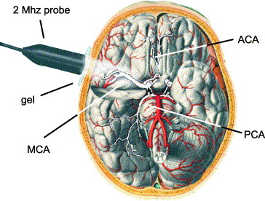
Aim of the study: examination of the acute effects of alcohol consumption on cerebral blood flow regulation with transcranial Doppler
Cerebral vasomotor reactivity: vasodilation capacity of cerebral arterioles to external stimuli, eg. increasing ec. pCO₂
Neurovascular coupling: functional hyperaemia, close coupling of cerebral perfusion to cerebral metabolism and neuronal activation

Slide 4
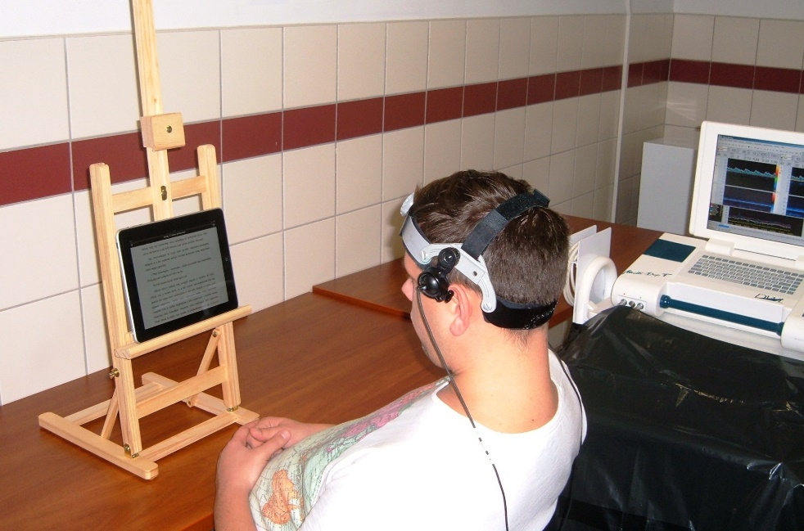
Methods
30 young healthy adults (15 males, mean age: 24,1 ± 1,6 years)
Examinations performed before and after achohol consumption:
blood pressure and pulse registration
VEP: neuronal activity of the visual pathway
TCD examination:
resting absolute flow velocity values – PCA & MCA
cerebral vasomotor reactivity: BHI – MCA
neurovascular coupling: visual stimulation (reading) – PCA
aim blood alcohol content: 0,8 g/L

Slide 5
Effects of acute alcohol consumption on VEP P100 wave
 | Latency (ms) |  | Amplitude (µV)
before alcohol | 108,0 ± 2,4 | p=0,001 | 9,7 ± 3,2 | p=0,011
after alcohol | 110,8 ± 3,4 |  | 8,6 ± 3,4

Slide 6
Effects of acute alcohol consumption on resting absolute blood flow parameters
Absolute resting blood flow parameters in the PCA (cm/s)
 | before alcohol | after alcohol | p
PSV | 53,2 ± 12,8 | 55,8 ± 13,0 | 0,002
TAMV | 34,5 ± 9,3 | 37,4 ± 9,8 | <0,001
PI | 0,85 ± 0,14 | 0,76 ± 0,14 | <0,001

Slide 7
Effects of acute alcohol consumption on cerebral vasomotor reactivity
130
100
70
Breath holding
BHI (%/40s)
before alcohol | 44,1±11,4 | p=0,001
after alcohol | 34,9±14,3
-10 0 10 20 30 40 50 60
before alcohol
after alcohol

Slide 8
Effects of acute alcohol consumption on neurovascular coupling
p=0,286
before alcohol
after alcohol
TAMV | Maximum increase (%) | p | Latency (s) | p | Steepness of rise of the flow velocity curve (%/s) | p
before alcohol | 127,3±7,6 | 0,02 | 12,9±3,6 | <0,01 | 4,7±1,4 | <0,01
after alcohol | 125,6±7,1 |  | 14,7±2,7 |  | 3,2±1,0

Slide 9
Conclusions
Acut alcohol consumption in low-to-moderate doses…
inhibits the visually evoked occipital cortex activation
results in dilation of cerebral arterioles
causes decreased cerebral vasomotor reactivity
compromises the neurovascular coupling

Slide 11
Thank you for your attention!
Funding:
Hungarian National Brain Research Program (NAP_13-1-2013-0001, 2017-1.2.1-NKP-2017-00002),
Economic Development and Innovation Operative Programme (GINOP 2.3.2-15-2016-00043 (Ironheart)),
Cerebrovascular and Neurodegenerative Research Group, Hungarian Academy of Sciences, University of Debrecen.

